Slide 1
The Million Dollar Question
Does Major League Baseball Payroll Contribute to Wins?
Trent Leslie, 2021, Technical Audience

Slide 2
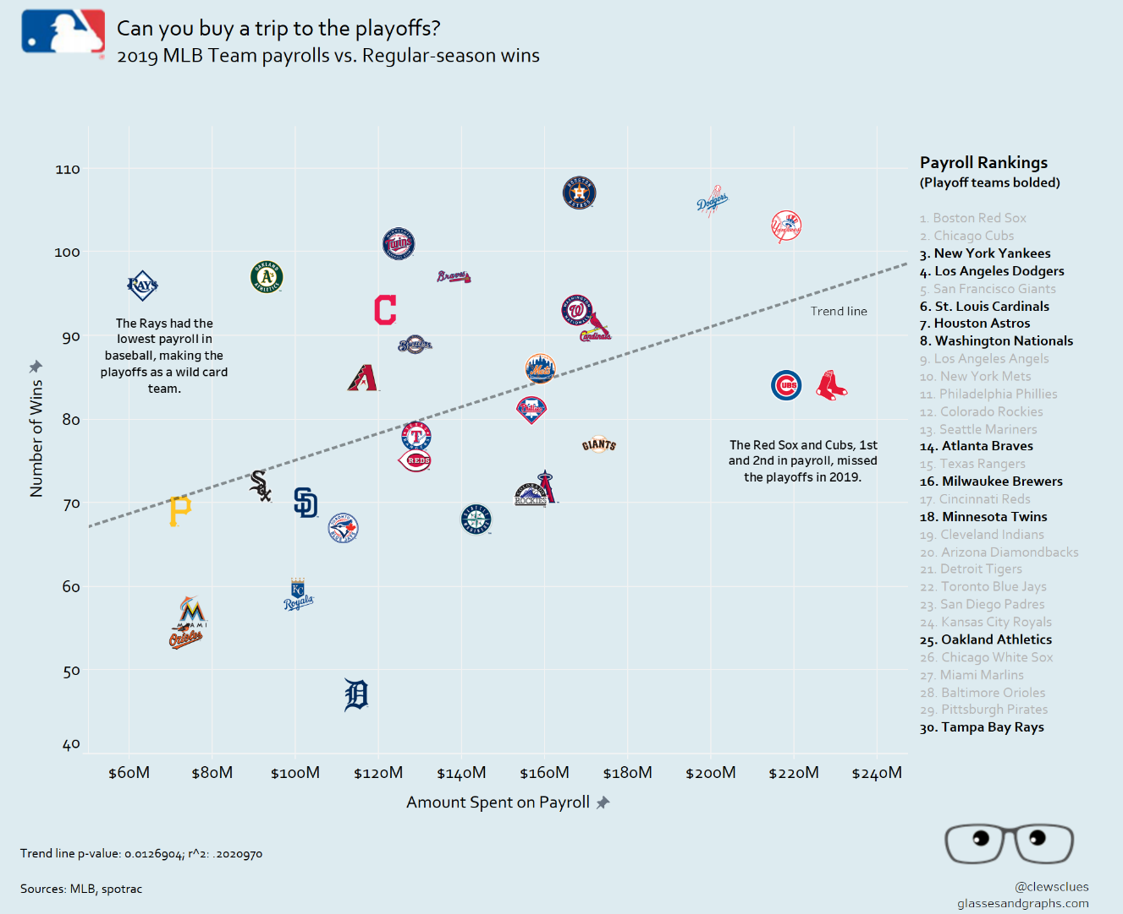
On Deck
In honor of the World Series, let’s revisit the age-old question of how payroll impacts a team’s success in Major League Baseball
Payroll often introduces a David & Goliath dynamic in baseball, particularly during the postseason
So, do small market teams have any chance at reaching the postseason like the Tampa Bay Rays in 2019?

Slide 3

The Data
Kaggle Baseball Databank
Teams Data (1985-2015)
Wins
Hitting & Fielding Stats
Payroll Data (1985-2015)
Player salaries

Slide 4

The Data
Data Normalization
All salaries adjusted for inflation for each respective year to 2021 dollars
Log transformation performed on all data to account for non-normal distributions
Outliers (>3 STDs) removed

Slide 5
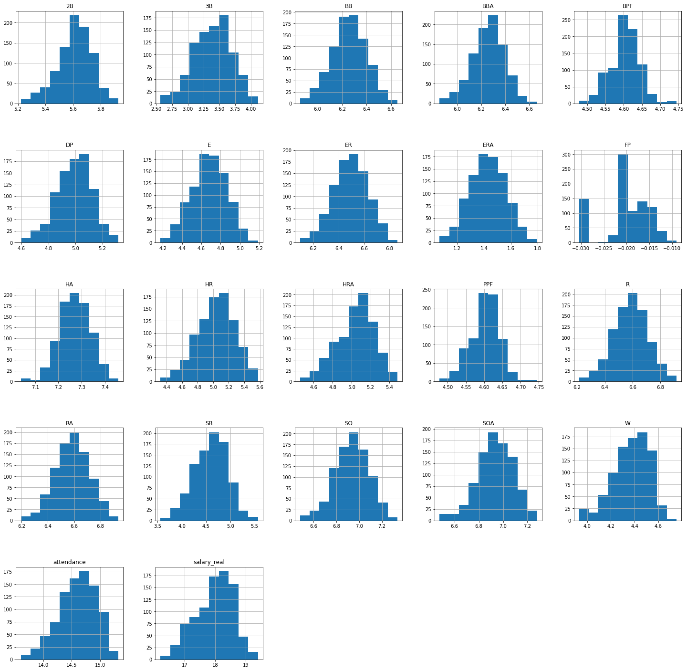
The Normalized Data

Slide 6
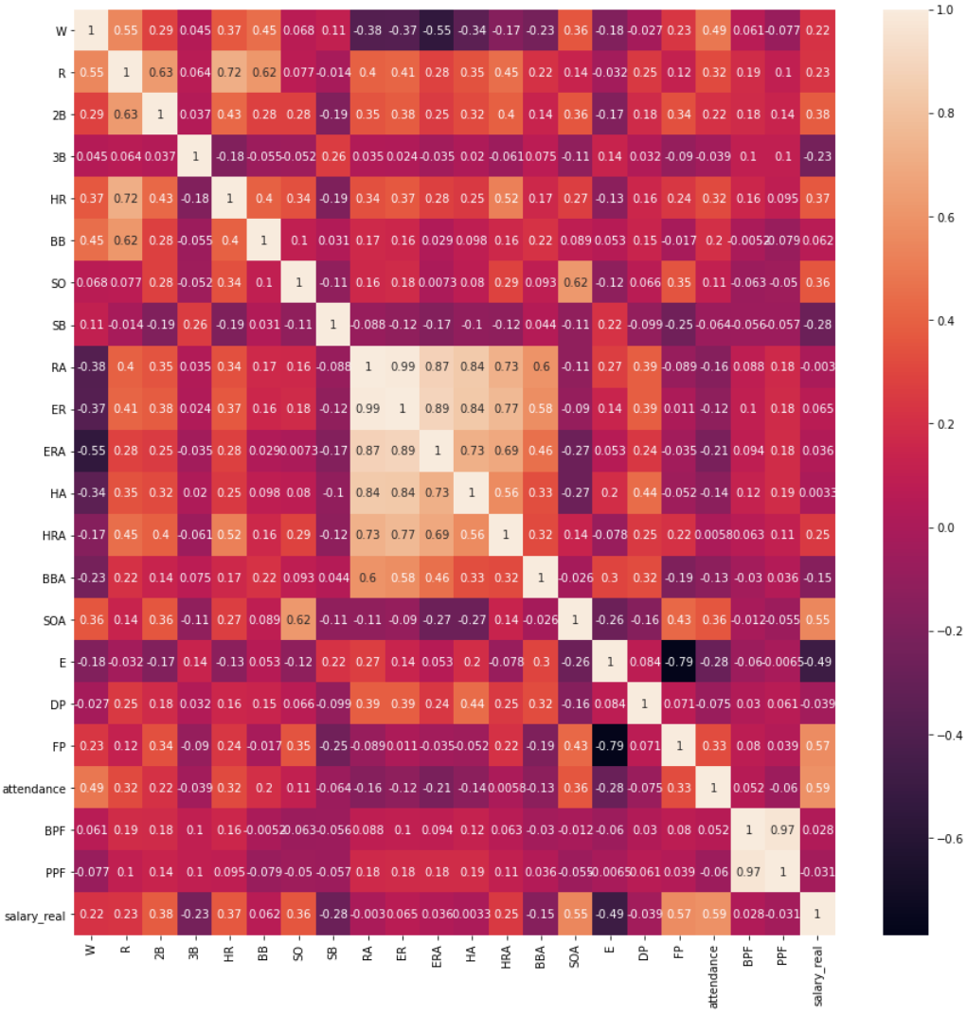
The Correlations
Bottom Row: Salary
Attendance (+)
Fielding % (+)
Strikeouts Allowed (+)
Left Column: Wins
Runs (+)
Earned Run Average (-)
Attendance (+)
Salary & Win Correlation
0.22, not a great correlation

Slide 7
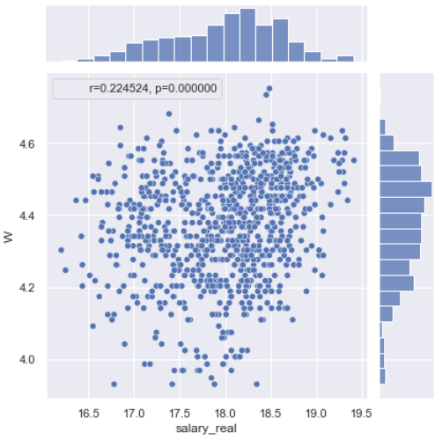
The Wins vs. Salary Linear Regression
This remarkably supports the chart from the first slide, but the sample size essentially drives the p-value to zero
The p-value pretty much rules out any chance of this observed data given there isn’t a relationship between wins and salary
But can it be as simple as spending money on payroll?

Slide 8
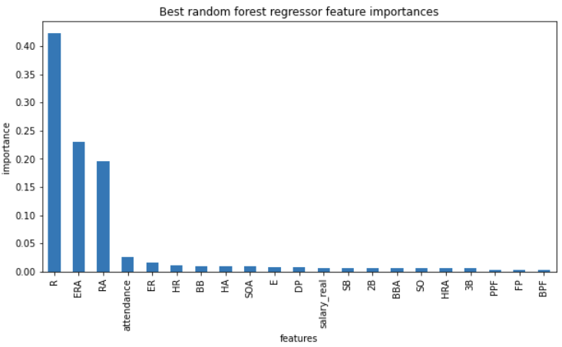
However, a Random Forest Wins Model
Random Forest (adj R2 = 0.81)
Contributors to wins dominated by runs, earned run average, and runs allowed
Salary is 12th in importance for modeling Wins
Not a compelling case for wins

Slide 9
But wait…
But wait – doesn’t salary pay for runs and pitching by paying more for the increased talent that delivers the runs and pitching?

Slide 10
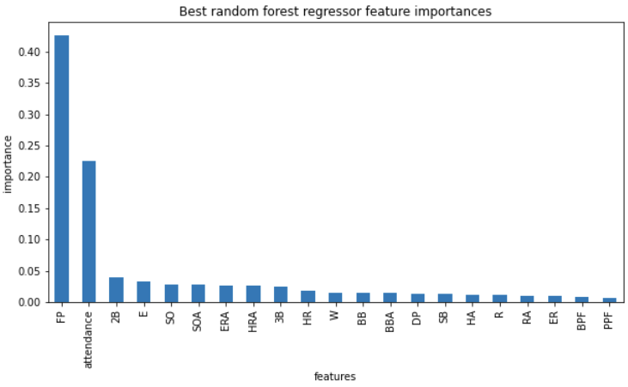
Salary mostly pays for fielding.
Random Forest (adj R2 = 0.66)
The two major contributors to salary is fielding percentage and attendance.
Wins is 11th in importance for modeling Salary
Also not a compelling case

Slide 11
Salary mostly pays for fielding.
The random forest models suggest that what explains the variation in payroll does not explain the variation in wins.
Attendance is interesting – a chicken or egg problem perhaps?
What explains wins?
What explains payroll?

Slide 12
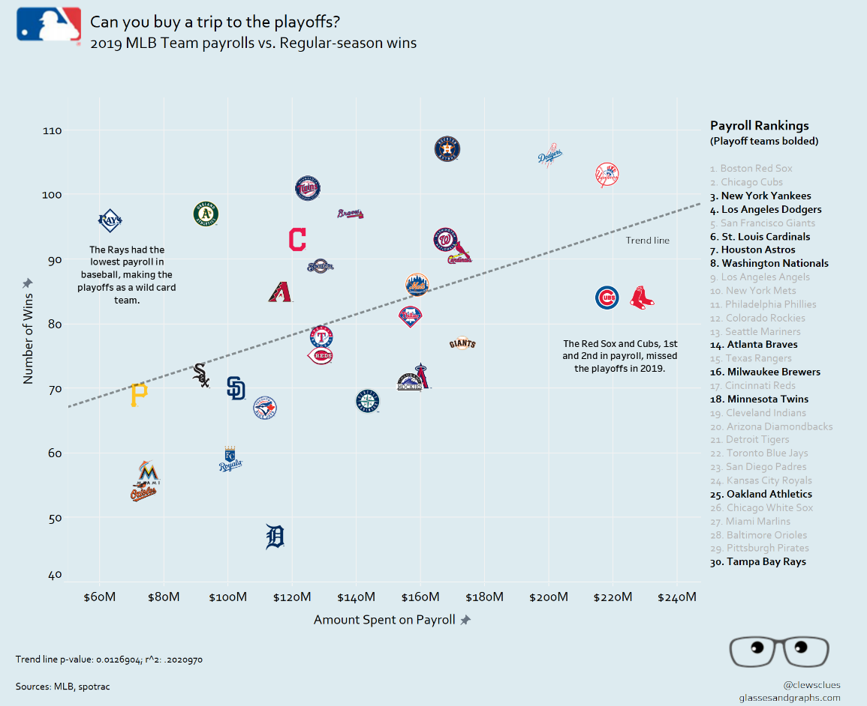
Rounding Third and Heading for Home
While there is clearly a relationship between wins and payroll, it neither rules out a #30 payroll team from making the playoffs or guarantees a #1 payroll team making the playoffs.
All-stars can be overpaid, and scrappy teams can have the x-factor of team chemistry

Slide 13
Rounding Third and Heading for Home
Regardless, higher payroll and the fielding percentage it allegedly brings probably doesn’t hurt
Underdogs are more fun to root for anyway (especially if they have a nonzero chance)

Slide 14
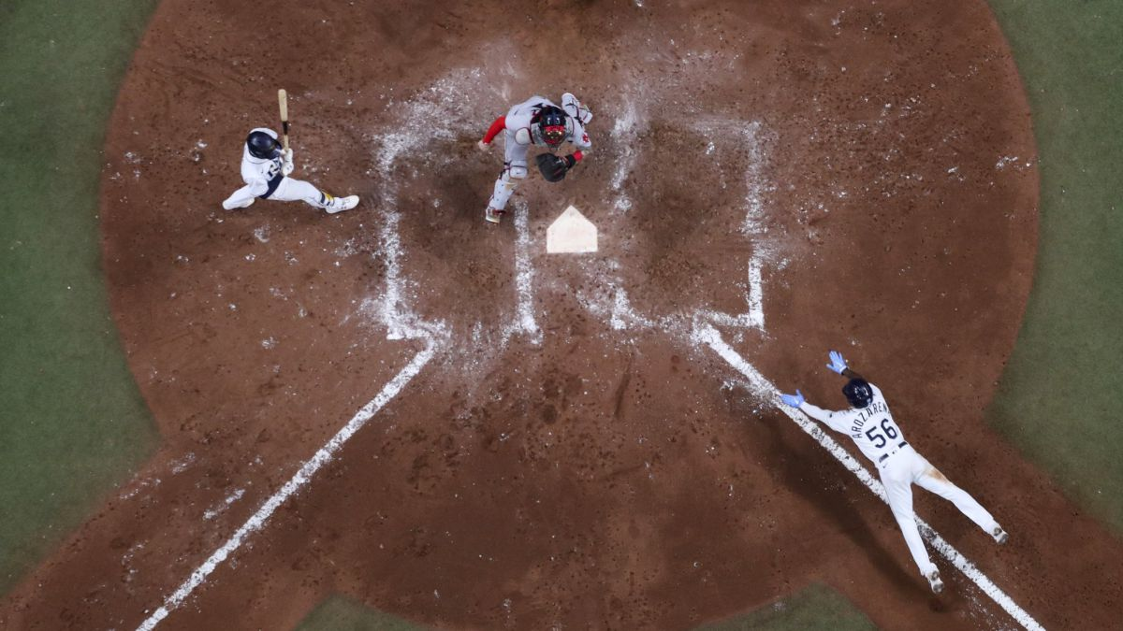
Sliding into Home
Future Considerations
Modeling making it to the postseason (a binary) instead of wins
Modeling winning the World Series (for fun)
Out of curiosity, further investigate the relationships to attendance

